Slide 1
Project 1: Public Transportation and Weather
Created by: Ivan Chan
Presentation date: 31 August 2023

Slide 2
Content page
Problem statement
Target Audience
Scenario
Problem
Hypothesis
Outside context research
Reason for the problem
The root of the problem
Analysis
Graphs
Insights (outliers)
Conclusions
Answer hypothesis
Recommendations
External sources used

Slide 3
Problem statement
Target Audience: Weather-transport app developers in Singapore.
Problem: The impact of weather on public transportation in Singapore.
Research Objective: Showcase the plans for a simplified mobile application for real-time weather-based updates on public transportation delays and disruptions.
Scenario: Rainy day commutes and the need for informed decisions.
Hypothesis: The application will assist commuters in making more informed decisions during rainy day commutes.

Slide 4
Outside context research
Noted similarities in the methods used by Zhou et al. in Shenzhen, China, and the approach taken in this study for understanding weather's impact on public transportation in Singapore.
Reference: Zhou et al., 2017
Notes:
In our pursuit to understand the impact of weather on public transportation in Singapore, we sought valuable insights from existing research. Although the study conducted by Zhou et al. (2017) focused on the Shenzhen province in China, it offered a robust methodology and data collection framework that we found highly relevant to our own research endeavors.
Zhou et al. (2017) explored the effects of weather on public transport ridership through a meticulous analysis of data from various sources. While the specific findings pertained to Shenzhen's context, the methods they employed to analyze the relationship between weather conditions and ridership can be adapted to our study in Singapore.
By referencing Zhou et al. (2017), we acknowledged the importance of understanding the methodology behind data collection and analysis. This acknowledgment guided our approach in gathering and interpreting data from Singapore's public transportation system, adapting their techniques to suit our unique climate and transportation infrastructure.
In summary, while the geographical scope of our research differs, the methodologies and principles derived from Zhou et al. (2017) have served as valuable foundations for our study on the impact of weather on public transportation in Singapore.

Slide 5
Outside context research
So why bother?
Public transportation is a vital component of urban life, impacting daily commutes, accessibility, and the environment.
Weather-related disruptions can lead to delays, inconvenience, and safety concerns for commuters.
Understanding the relationship between weather and public transportation is essential for improving services, ensuring commuter safety, and optimizing resources.

Slide 6
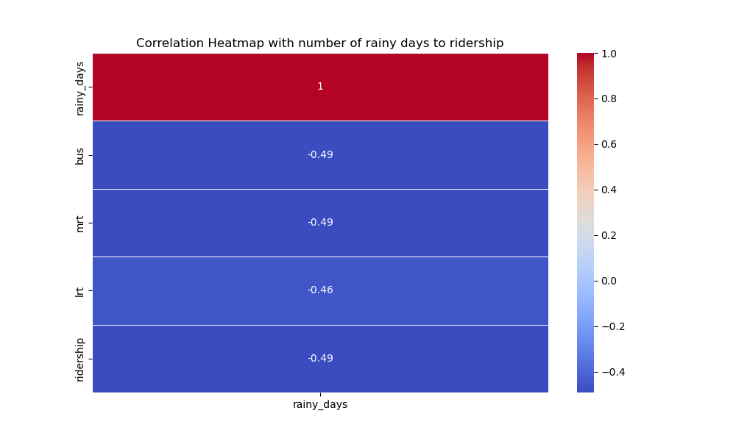
Correlation of number of rainy days to ridership
Bus = Public Buses, mrt = Mass Rapid Transit, lrt = Light Rail Transit, ridership = total ridership
Day only counts as rained if said day had at least 0.2 mm of rain
Notes:
There seems to be a negative correlation between the number of rainy days and the various ridership of moderate strength. That means if the month has more rainy days, people are less inclined to take public transport. There are definitely other factors involved too.

Slide 7
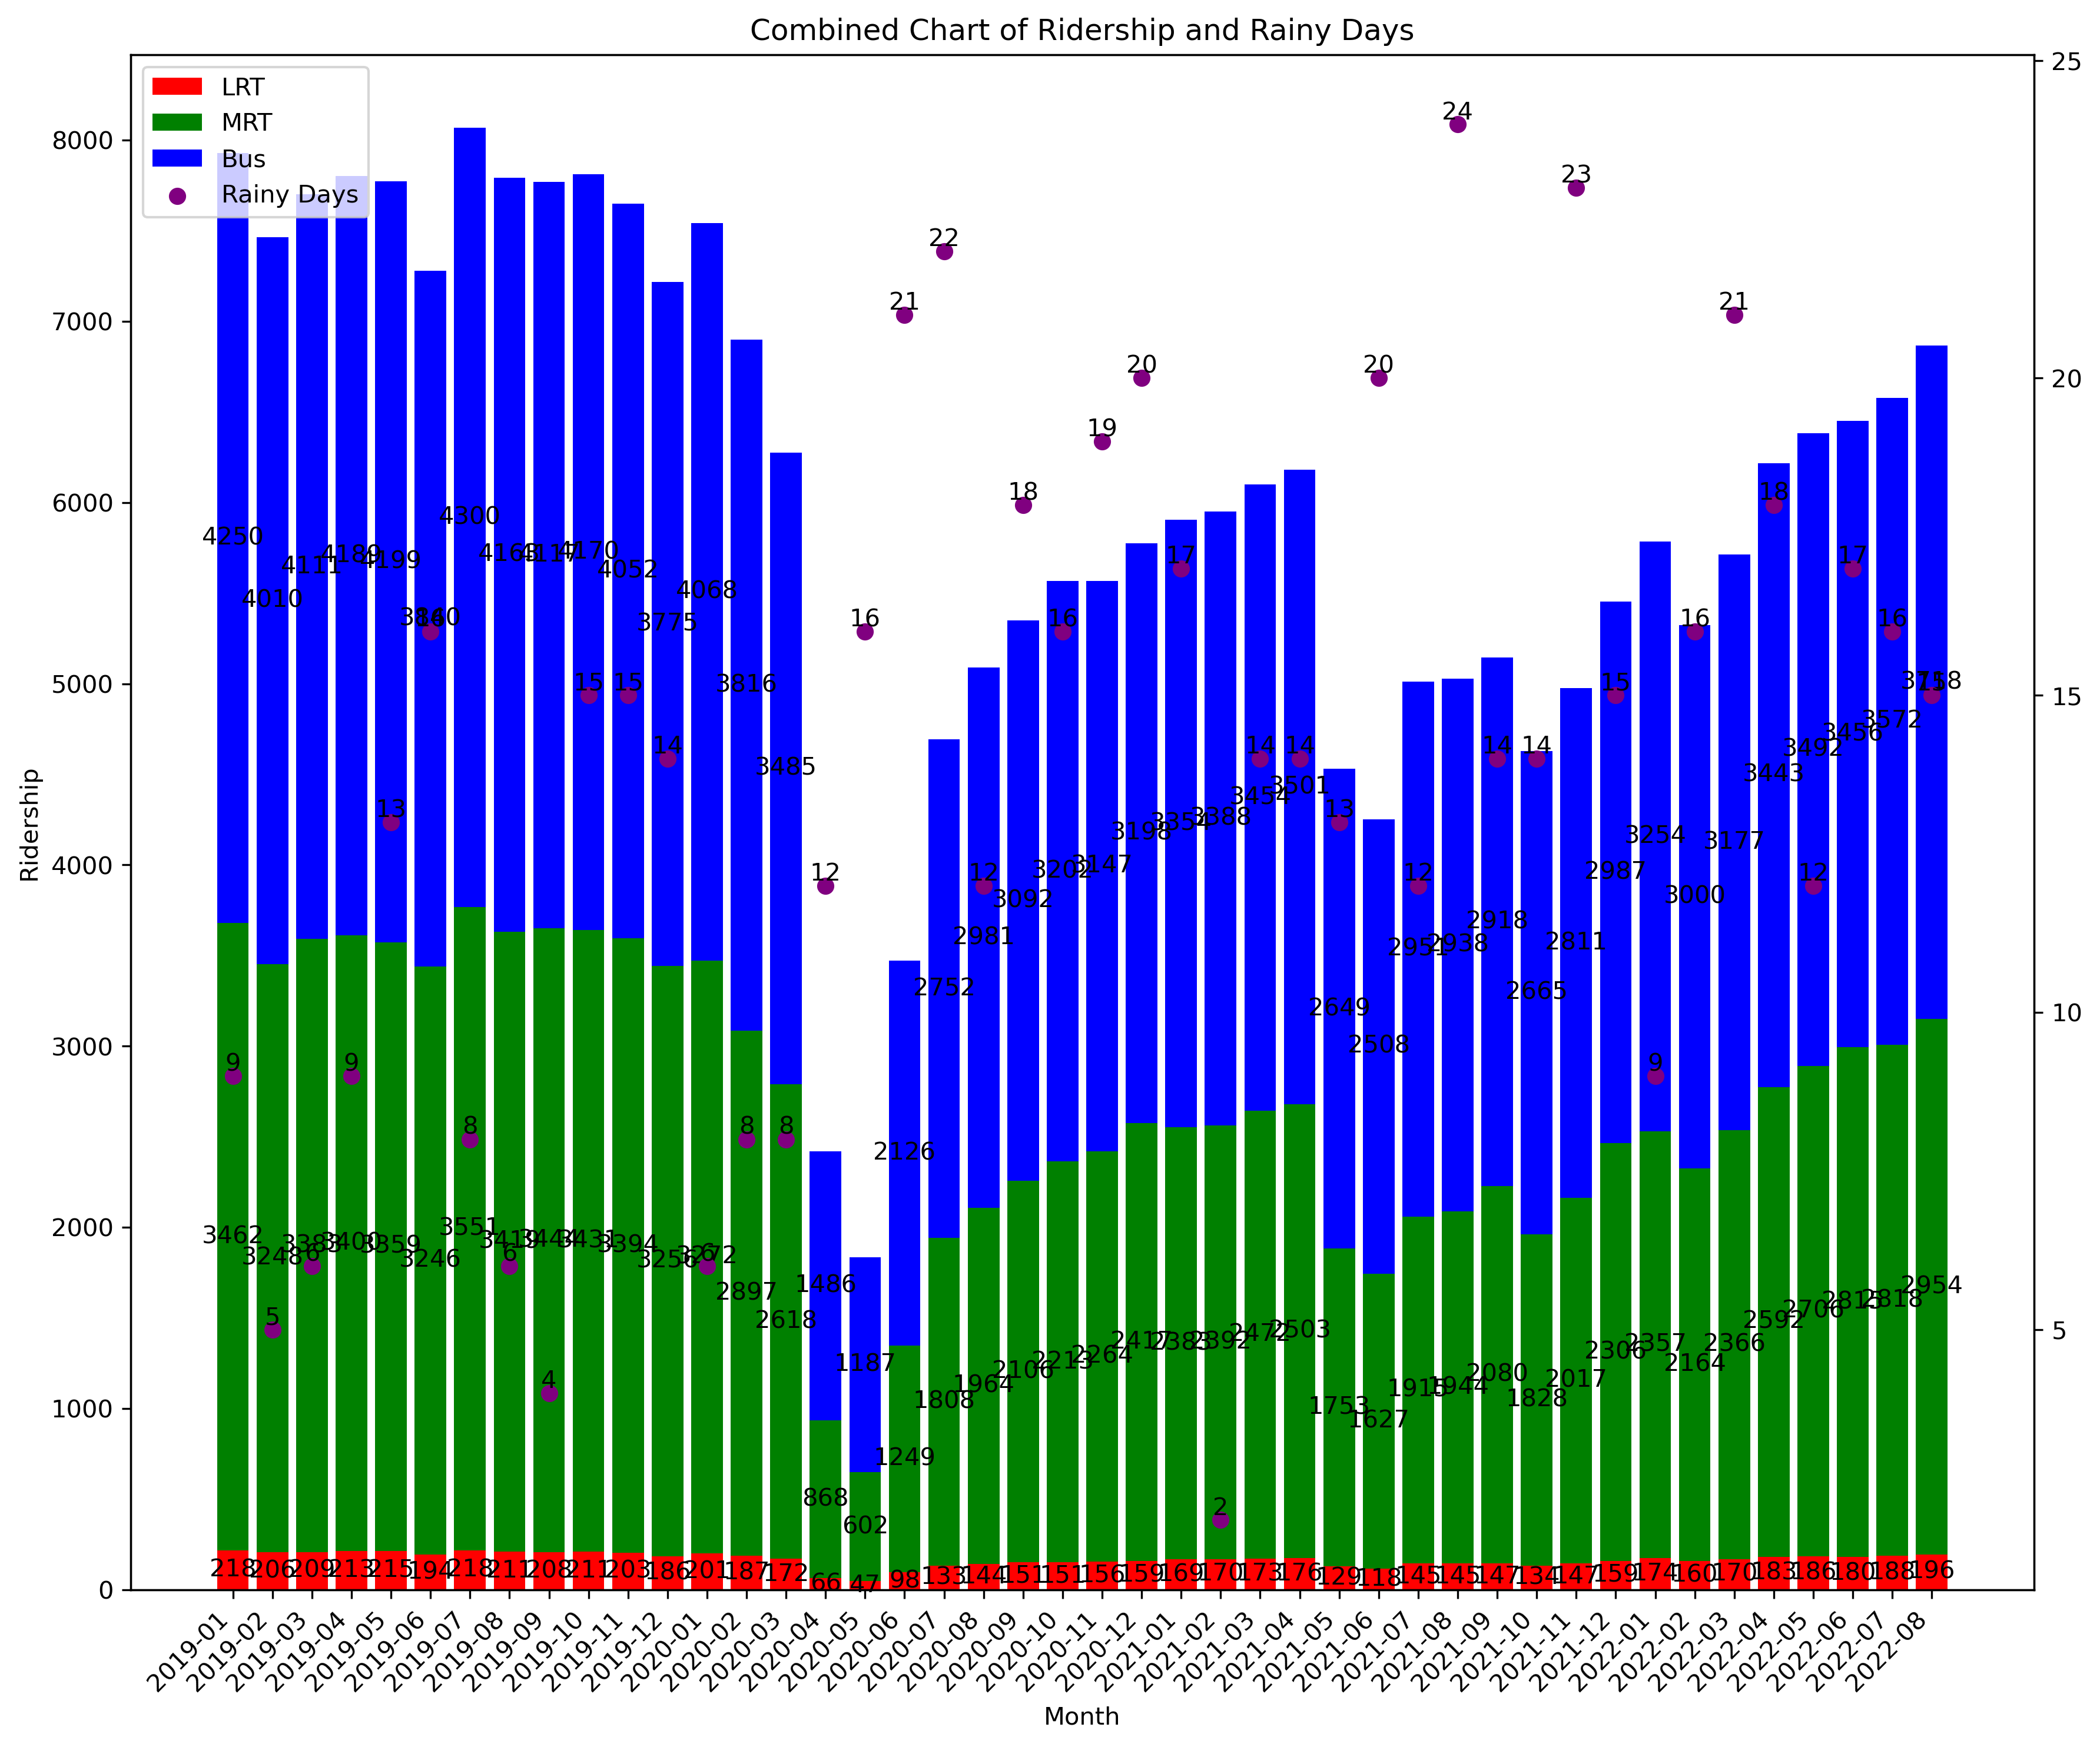
Chart of rainy days to ridership from January 2019 to August 2022
Notes:
*Cue bouncing*
Why? Well… there was this simple case of covid restrictions, as shown by this news article: T. (2020, April 17).

Slide 8
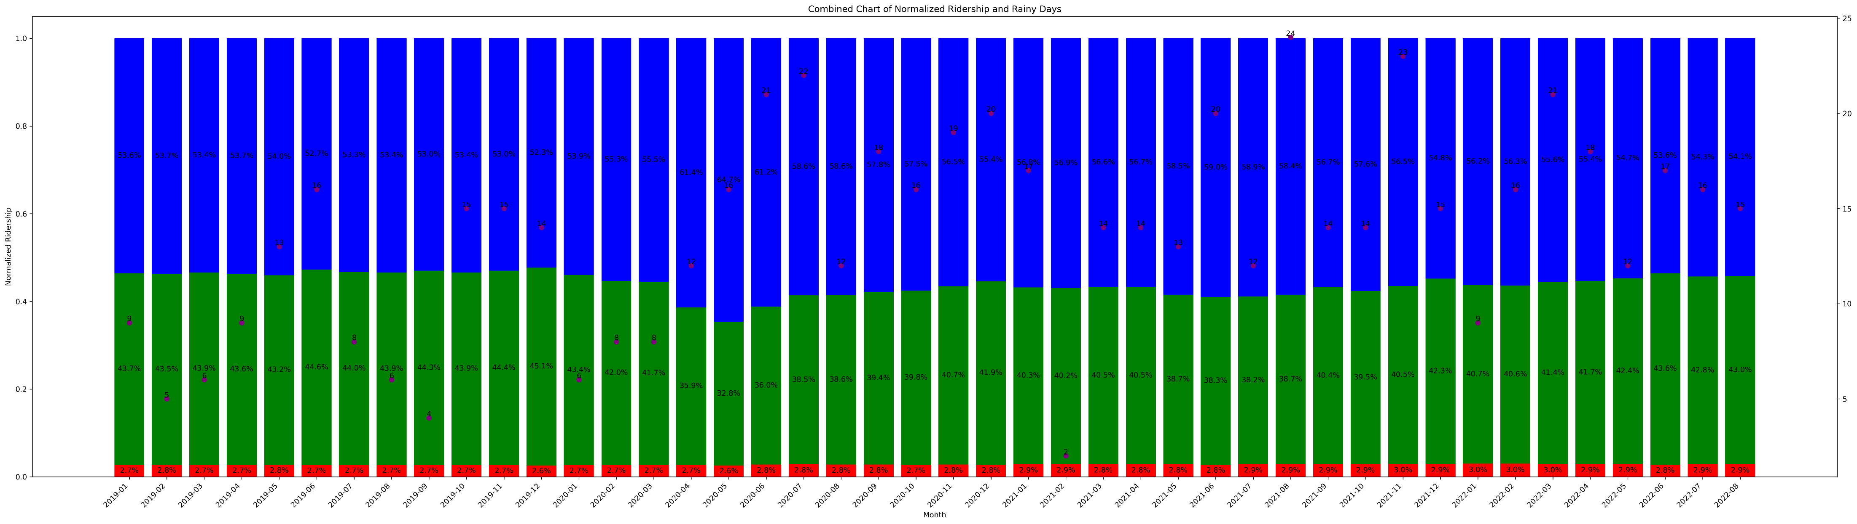
Normalized chart of rainy days to ridership from January 2019 to August 2022
Notes:
With a noticeable drop for the period between April 2020 to June 2020, I normalized the data. Now it mostly follows the trend.

Slide 9
Conclusion
Hypothesis answer:
Might not be answered fully with limitation
Trend shows less people ride public on rainier months
Notes:
Why not other weather-related dataset? Mention how other weather when checked with the correlation produced an even worse relation value, implying almost no link at all.

Slide 10
Limitations and future for this project
Project only covered public transport
Might look into private sectors like Grabshare as well
Project only had data between the selected periods
Time-constraint and budget.
Taxi is considered a public transport but data not found in timely manner.
Scope of data issue
Unlike Shenzhen’s data, Singapore’s data doesn’t cover peak and off-peak.
Notes:
Although taxis are considered a form of public transportation, unfortunately, relevant data pertaining to their usage in relation to weather conditions could not be obtained within the constraints of this study's timeframe.

Slide 11
Recommendations
Budget to allow better research
Improve Data Collection
Further Research

Slide 12
External sources
Zhou, Meng, Donggen Wang, Qingquan Li, Yang Yue, Wei Tu, and Rui Cao. “Impacts of Weather on Public Transport Ridership: Results from Mining Data from Different Sources.” Transportation Research Part C-emerging Technologies. Elsevier BV, February 1, 2017. https://doi.org/10.1016/j.trc.2016.12.001.
LTA | Statistics. (n.d.). Statistics and Publications. Retrieved from https://www.lta.gov.sg/content/ltagov/en/who_we_are/statistics_and_publications/statistics.html
Rainfall - Monthly Number of Rain Days — Data.Gov.Sg, n.d. https://beta.data.gov.sg/datasets/1398/view
Covid-19: Govt announces closures of non-essential workplaces, schools from April 7 and 8. TODAY. https://www.todayonline.com/singapore/non-essential-businesses-schools-be-shut-april-7-and-8-pm-lee

